Slide 1
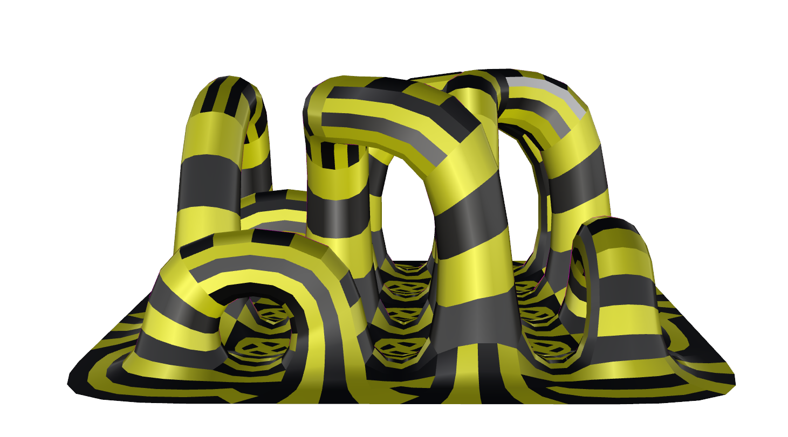
Project LoopS
Libish Murugesan
Vincent Verster
Notes:
This is the cover template
You might change just the title and the team members names (do not change fonts or colors here)
In case you collect some videos together in a longer one, use this as introductory image (5 seconds)

Slide 2
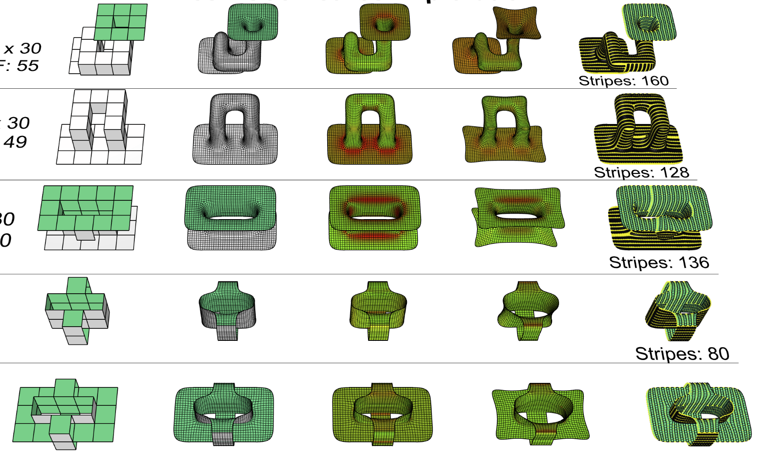
Mesh Topology Exploration
Mesh 1
40 X 50 X 30
V: 274 F: 88
Mesh 2
40 X 50 X 30
V: 144 F: 29
Mesh 2
30 X 50 X 30
V: 224 F: 56
Mesh 2
30 X 30 X 30
V: 216 F: 59
Mesh 2
30 X 50 X 30
V: 428 F: 144
Smoothed :
(Naked edges 1 & level 3)
Curvature Analysis
Relaxation
Stripes
Initial Mesh

Slide 3
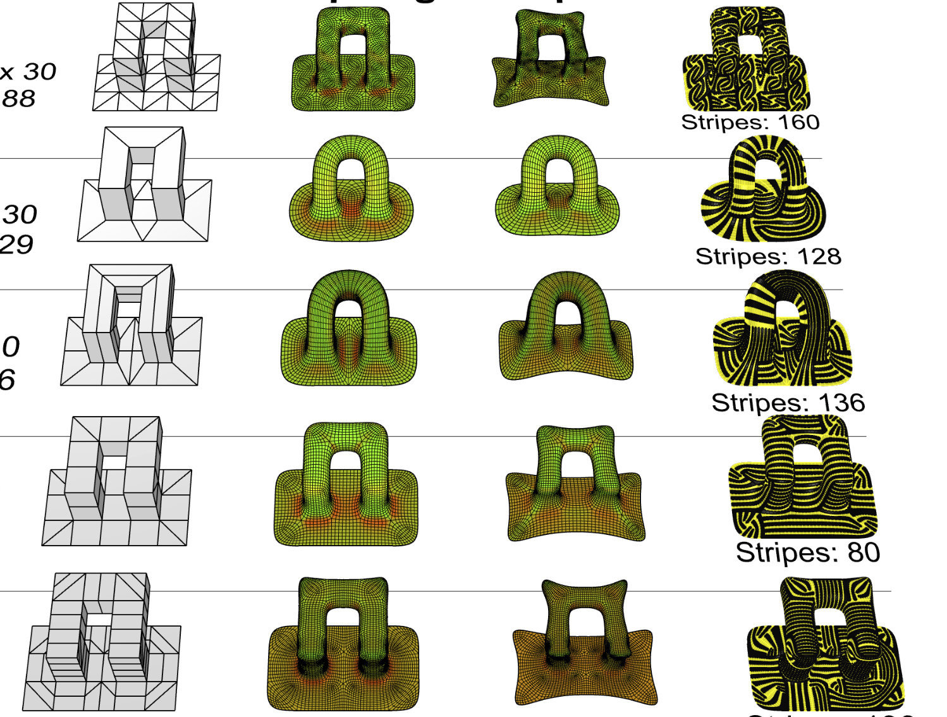
Mesh Topology Exploration
Mesh 1
40 X 50 X 30
V: 274 F: 88
Mesh 2
40 X 50 X 30
V: 144 F: 29
Mesh 2
30 X 50 X 30
V: 224 F: 56
Mesh 2
30 X 30 X 30
V: 216 F: 59
Mesh 2
30 X 50 X 30
V: 428 F: 144
Initial Mesh
Smoothed &
Curvature Analysis
Relaxation
Stripes

Slide 4
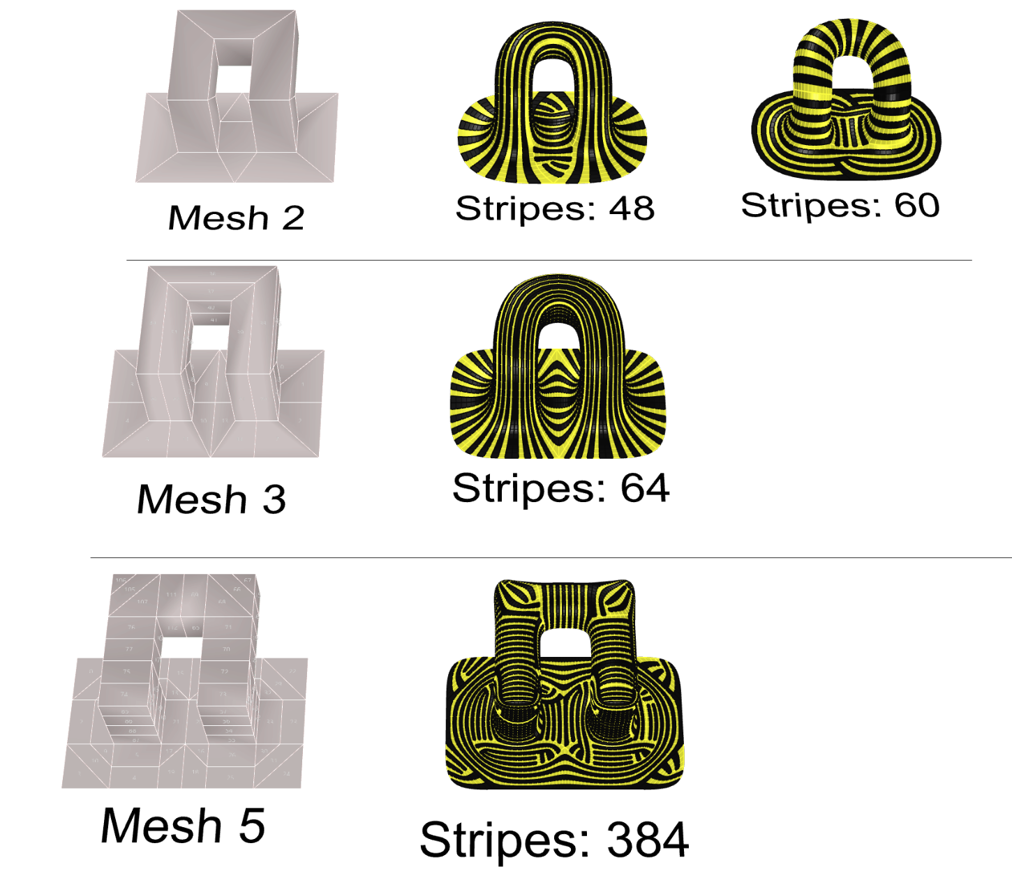
Mesh Topology - stripes

Slide 5
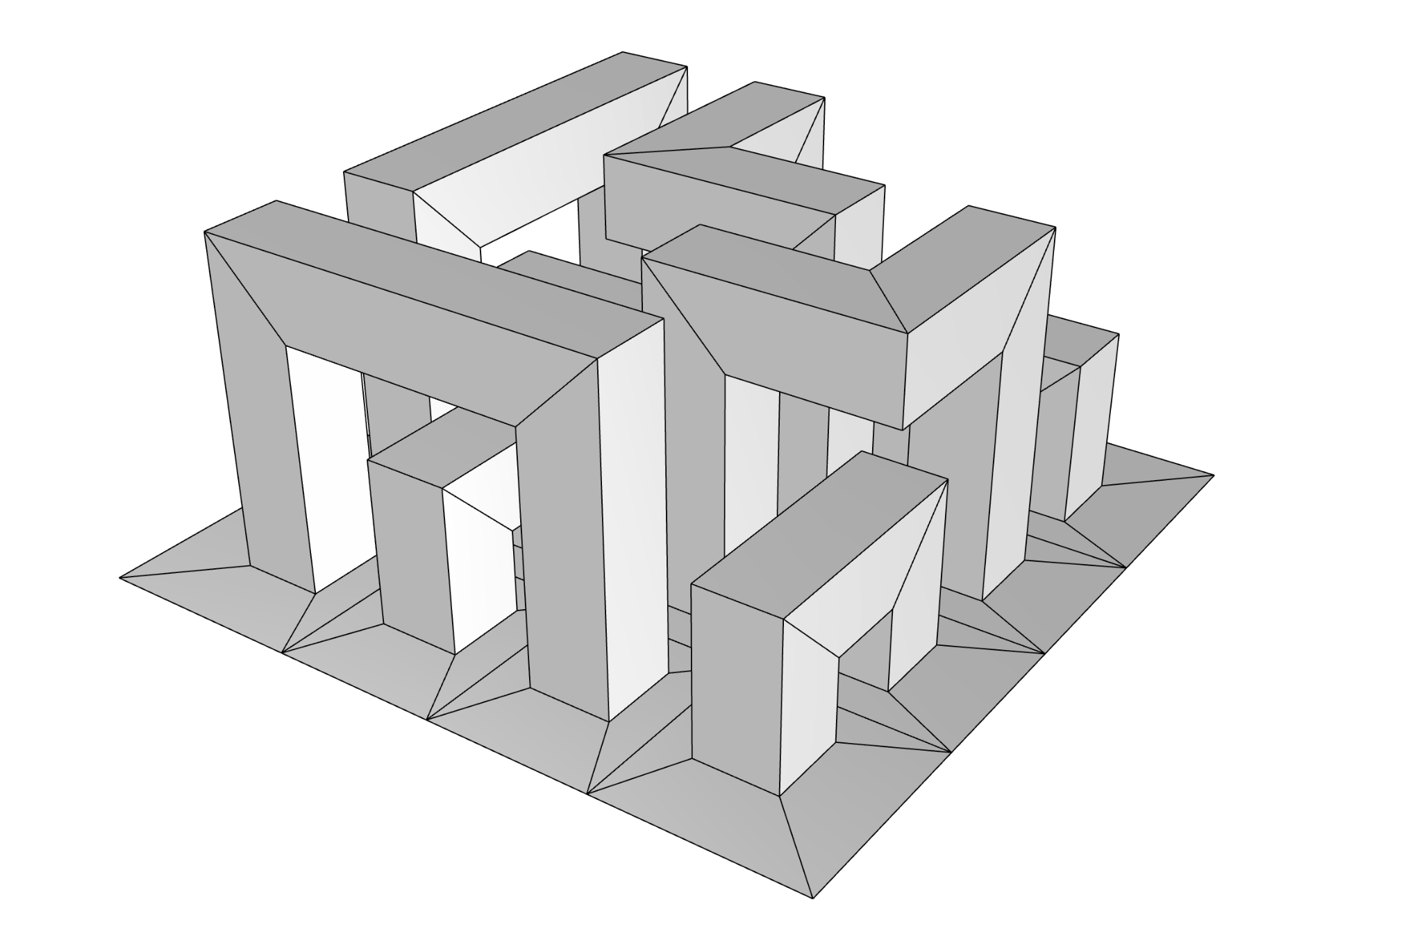
The Base Mesh: 4,5 x 4,5 x 4,0 m
V: 672 F: 168

Slide 6
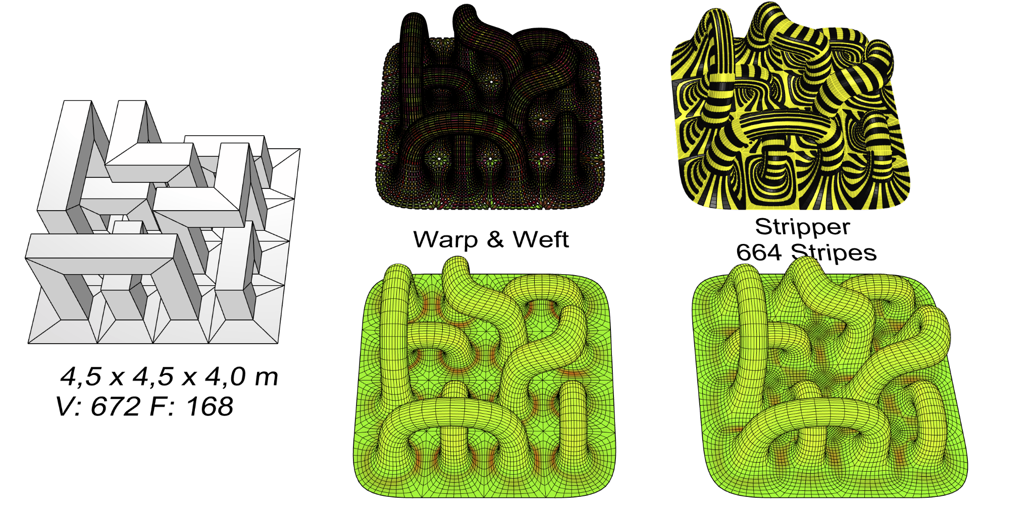

Slide 7
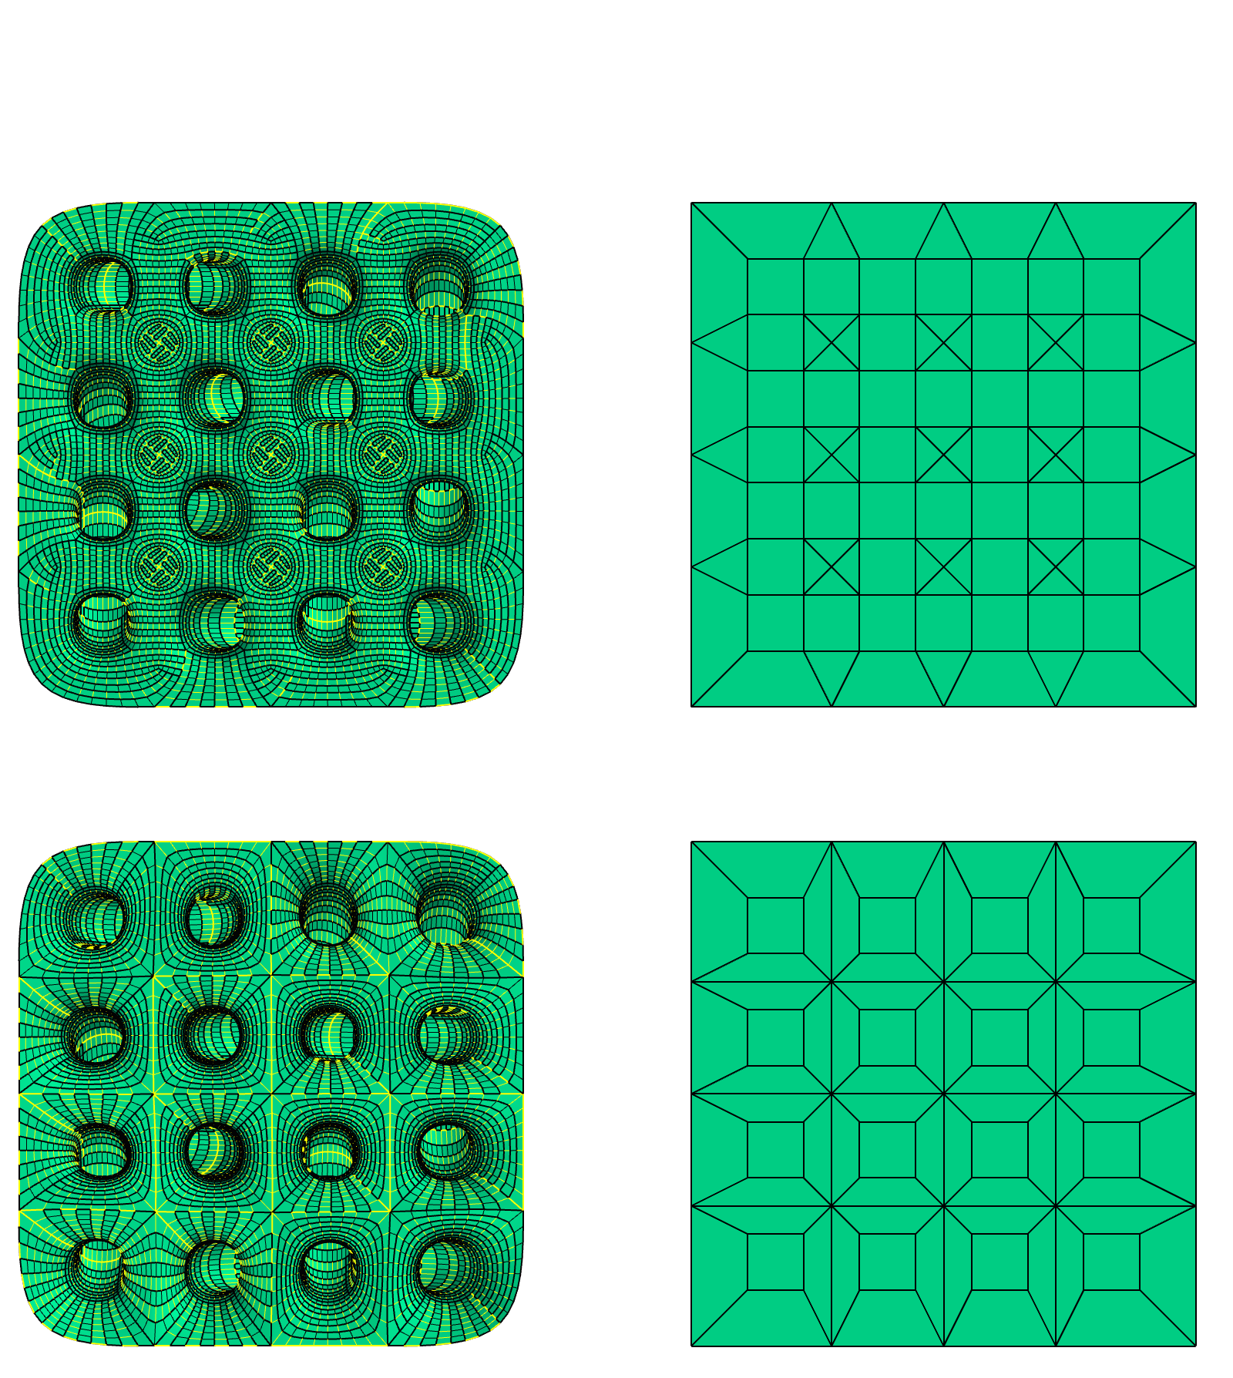
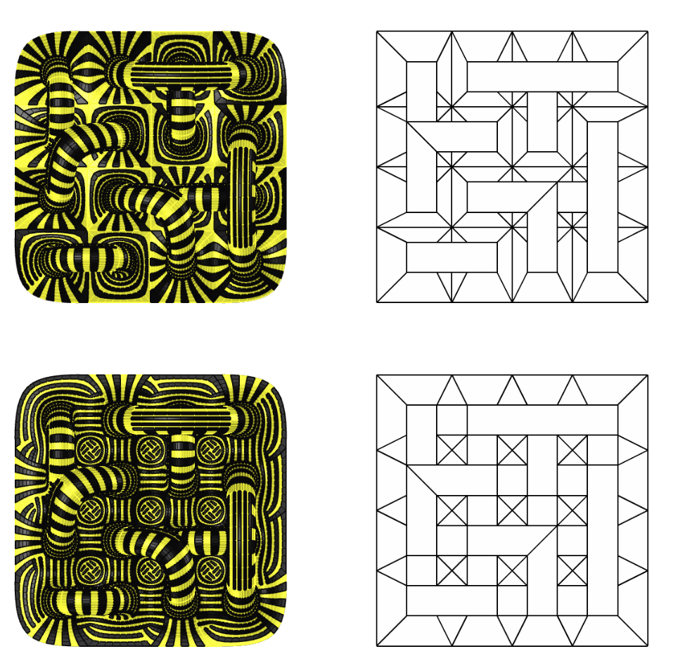
Top view
Bottom view
4,5 x 4,5 x 4,0 m
V: 720 F: 192
4,5 x 4,5 x 4,0 m
V: 672 F: 168

Slide 8
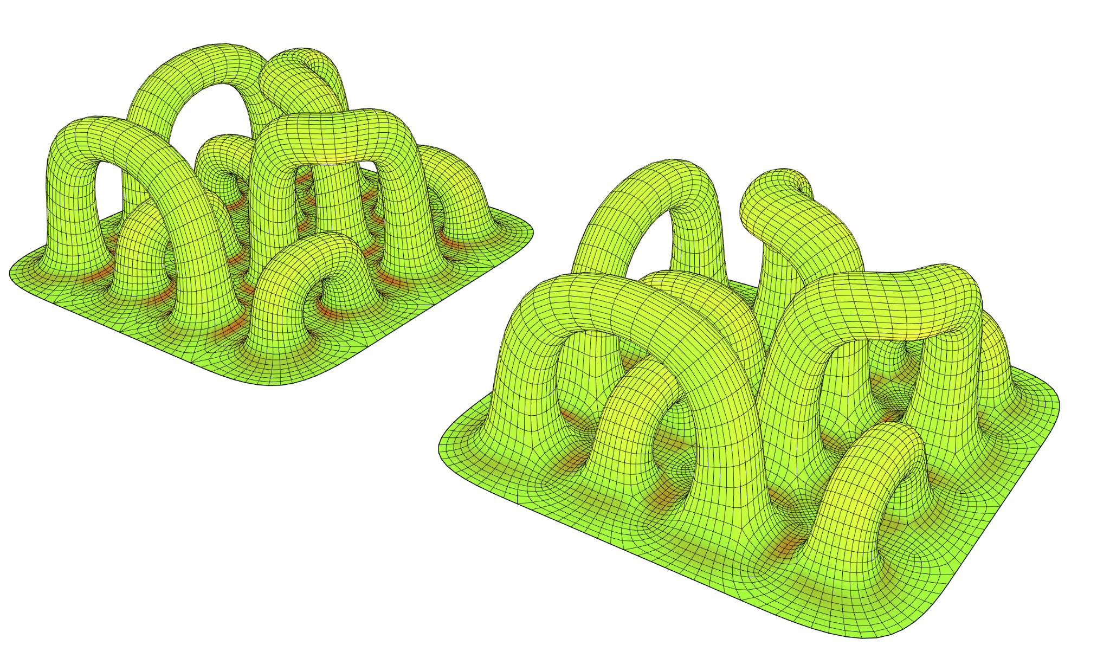
Relaxation
Catmull Clark &
Mesh Curvature

Slide 9
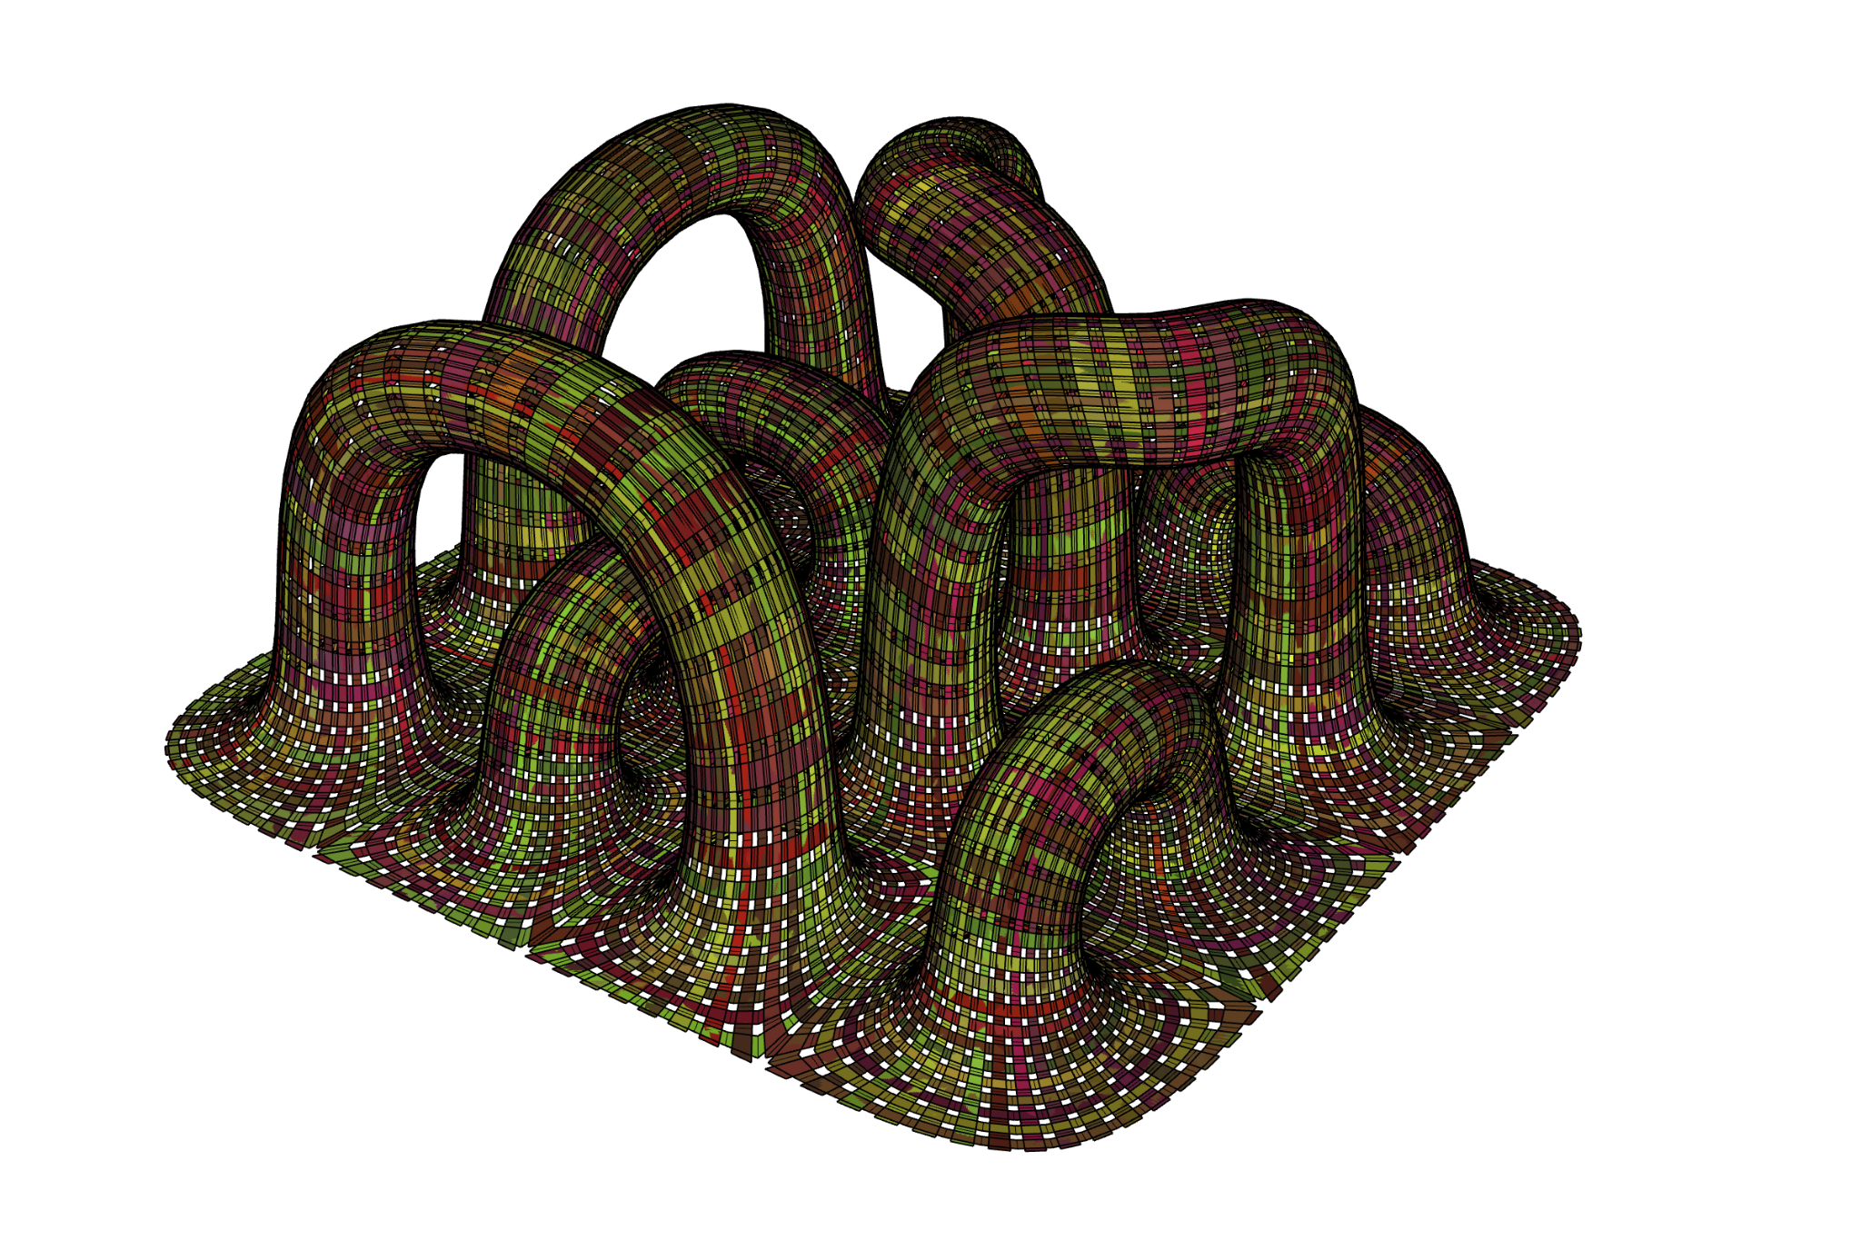
Warp and weft

Slide 10
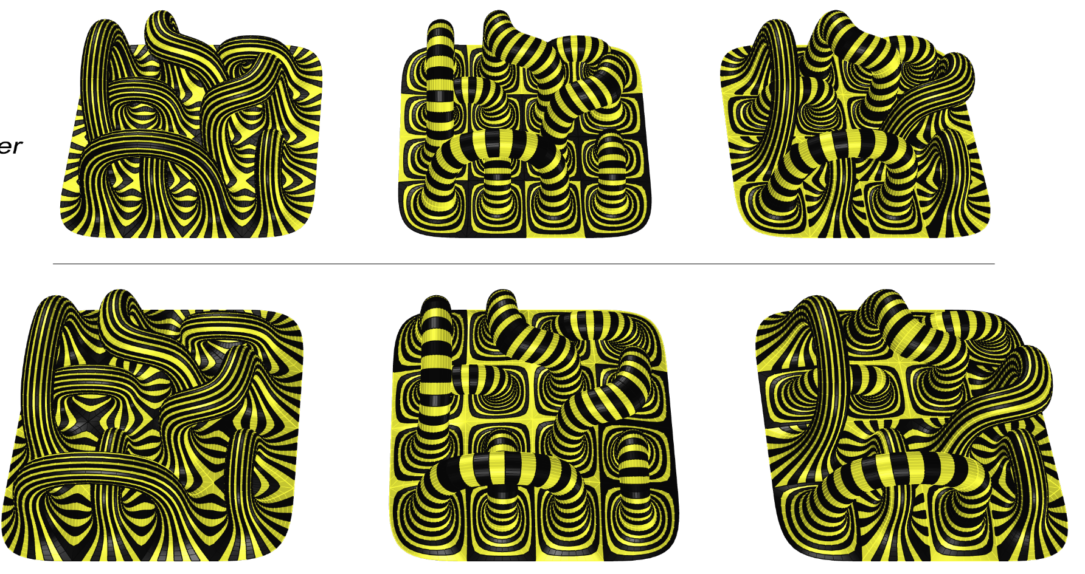
Stripes 96
Stripes 336
Stripes 264

Slide 11
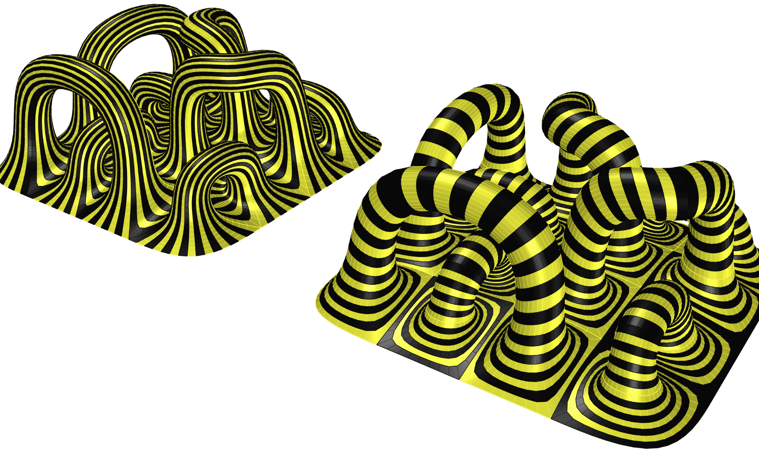
Stripes: 336
Stripes: 96

Slide 12
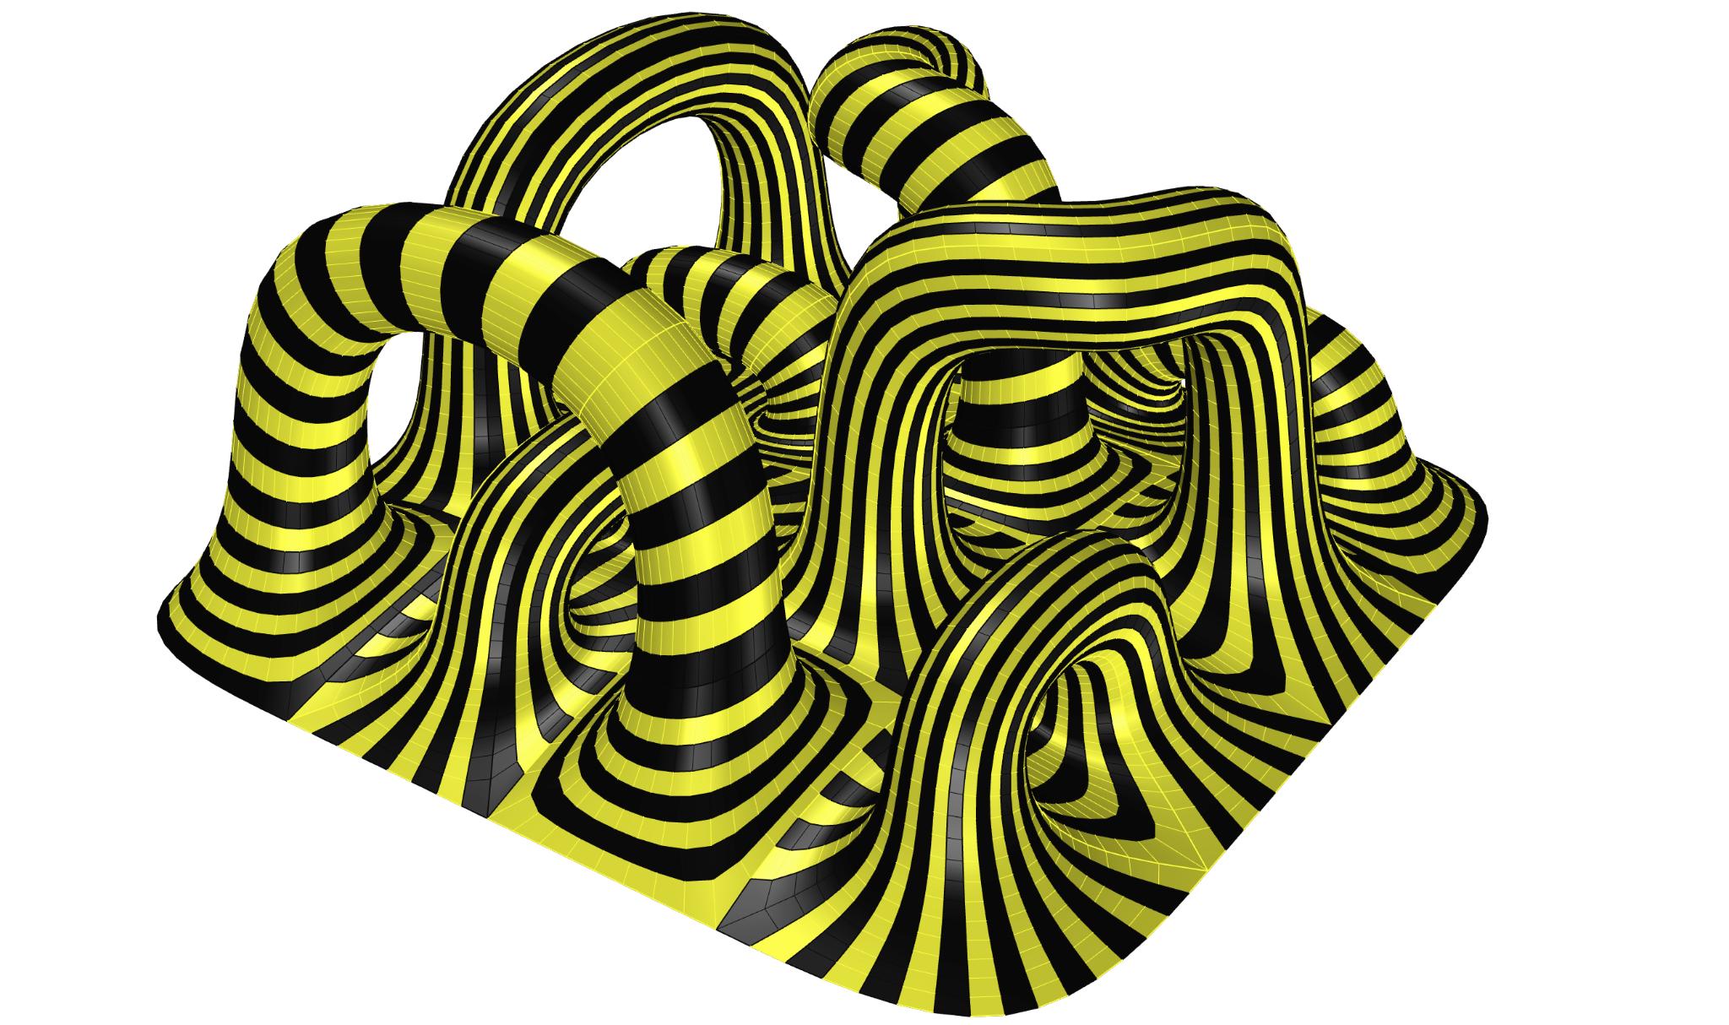
Stripes: 264

Slide 13
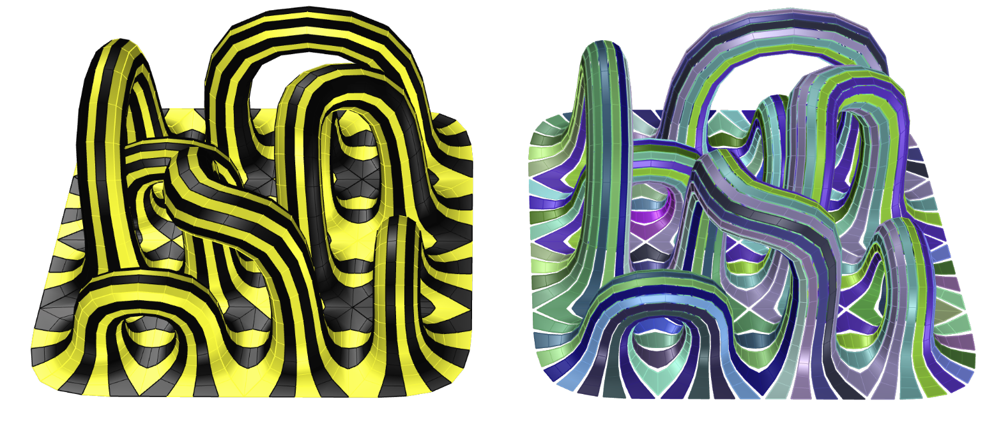
Mesh geometry stripping the
48 Strips of barisol Dimensions 4.5 * 4*4 m

Slide 14
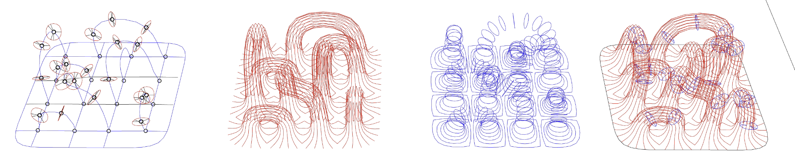
7 supporting frames
25 truss connectors
Dimensions 4.5*4.5*4 m
Vertical 150 members
Horizontal 168 members
Frame geometry for the Barrisol membrane

Slide 15
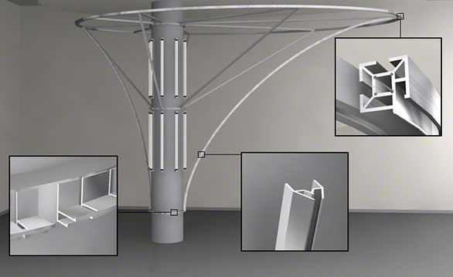

Slide 16
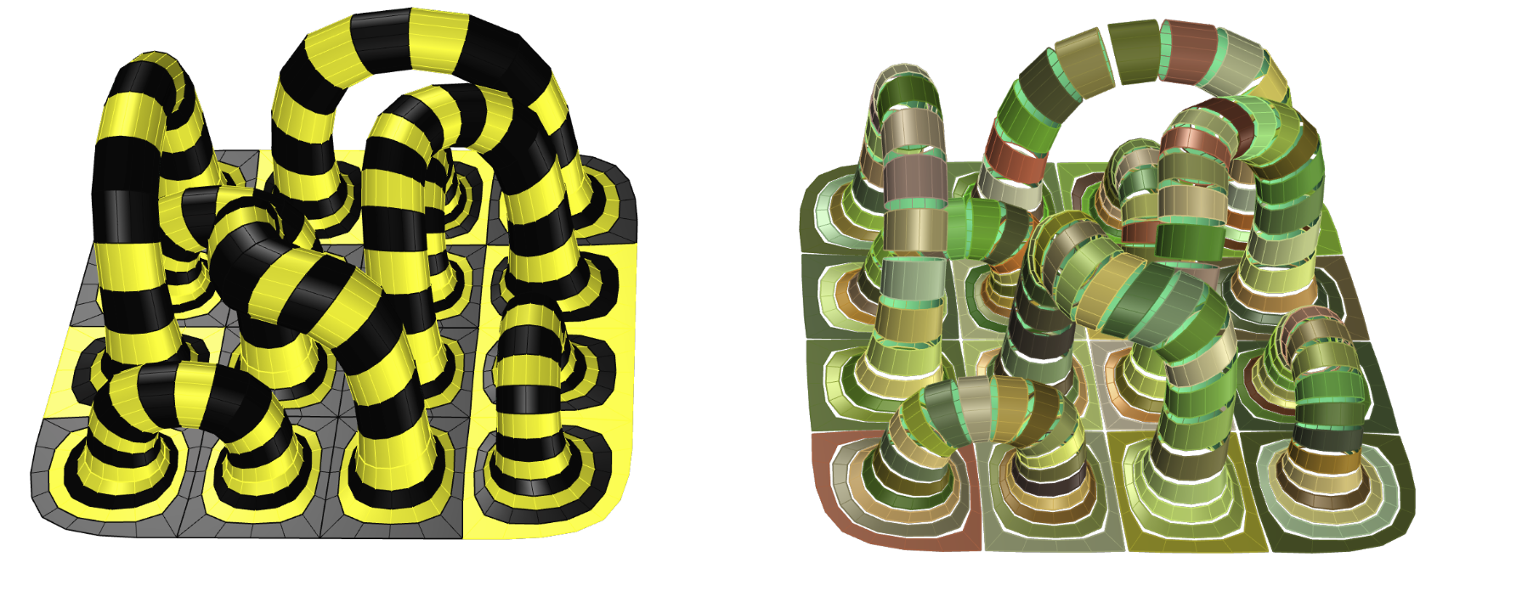
96 Strips of Tensile Membrane
Dimensions 4.5 * 10*10 m

Slide 17
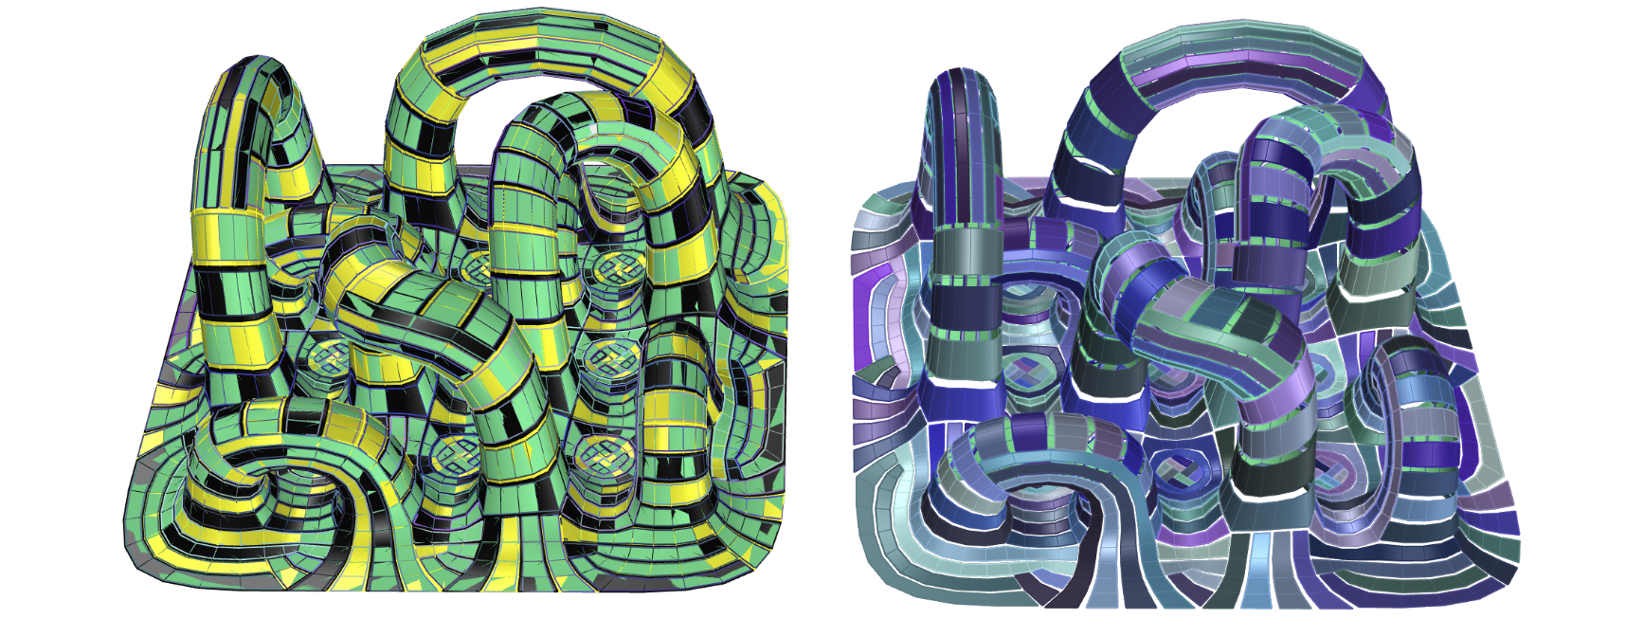
416 Strips of tensile Membrane
Dimensions 4.5 * 10*10 m

Slide 18
Notes:
The present and the following slides (slide 4 to 10) contain some indications and examples, do not include any of these in your final presentation

Slide 19
Presentation format notes
Text styles
Slides templates
. Cover slide: change only your names and project title
. black/white empty slides: base templates for any other slides, depending on your graphic palette. You can use other background colors but make sure the graphic elements blend seamlessly and do not overlap (see next slides for visual examples)
prescriptions
. renders should take the entire slide, unless a different aspect ratio is desired: in these cases, use the black background template
. no textual descriptions and/or long paragraphs. Projects should speak through diagrams and graphic alone. Limit text to titles, callouts, data and short paragraphs only if necessary.
To avoid inconsistencies, keep these text styles throughout your presentation. Preserve font and size - color can vary to match your graphic palette if necessary.
Title - Open Sans Normal 36 + Italic
Subtitle - Open Sans SemiBold 24 + Italic
paragraph - Times New Roman 20 + Italic
caption - Open Sans Light 18 + Italic
callout and data in graphics - Times New Roman 14 + Italic

Slide 20
project title / team member 1, team member 2, team member 3

Slide 21

Mesh Topology Geometries
. renders/diagrams should blend, not overlap 3/4
this slide has an image exported from Rhino (ViewCaptureToFile) in Rendered view mode and it blends seamlessly with the white slide template.
In this example calluots have been added here.
project title / team member 1, team member 2, team member 3

